Slide 2

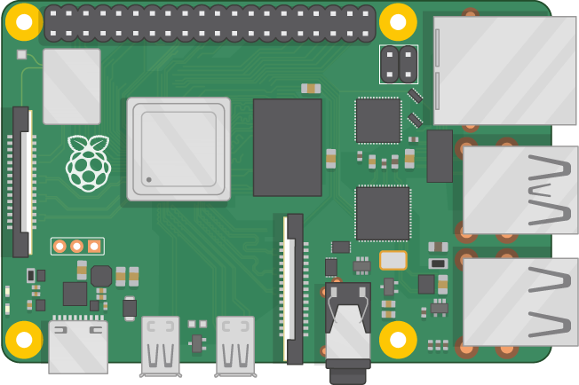
GPIO
WIFI

